Slide 1
IGME 689 vintage game design
day 1

Slide 2
making games for the atari 2600
day 1

Slide 3
right place?

Slide 4


Nick LaLone njligm@rit.edu
Notes:
I have been in and around games for ages and lately, I’ve been in spaces that can benefit from exploring the relationship between play and embodying roles. At the center of most of my work is space, disorder, and order.

Slide 5
the deal
Notes:
I am in the midst of making a course based on vintage game design. I want to include everything from the Fairchild Channel F up to around the SNES. Just a basic intro to how they work, making a game or a demo, and letting folks have a ton of historical context,

Slide 6


Slide 7
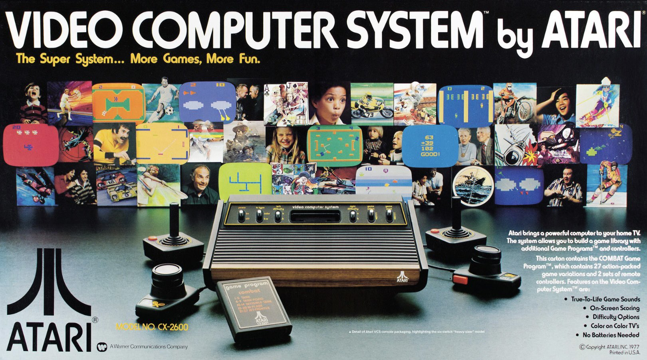
Notes:
So, Atari was not the first game company. Hell, it wasn’t even the first generation of console. It didn’t create video games, we can say those began even as far back as the 1800s with the mechanical turk.
But, this is where we can say video games established a few things.

Slide 8
not origin but where we began
Notes:
So, Atari was not the first game company. Hell, it wasn’t even the first generation of console. It didn’t create video games, we can say those began even as far back as the 1800s with the mechanical turk.
But, this is where we can say video games established a few things.

Slide 9
what matters? who cares?
Notes:
If Atari asn’t the origin but where we started, what parts of that matter? Who cares?

Slide 10
credits for designers
Notes:
Well, the first is probably the most important. We now know who designed games.
How many designers do you know?

Slide 11
3rd party games
Notes:
Because of the aura surrounding credits for designers, we got 3rd party games.

Slide 12
pipelines
Notes:
Atari used to lock employees in their offices and demand they could not leave til games were done. This style of work is now called crunch and seen as bad. It started here.

Slide 13
what a video game is
Notes:
Nintendo sort of owns this now as Microsoft is concerned with sales of its other divisions and Sony is as well. Sega partially cared but now all of the former care about gamers rather than games. We owe this path to Atari who ultimately lost control of the concept though it all sits at the center of what Nintendo now owns.

Slide 14
games before a frame buffer
Notes:
We take for granted everything related to space on a screen having a definitive xy coordinate system. This didn’t exist in the past. We have to write it, make it happen, and then go.
And it varies wildly.

Slide 15
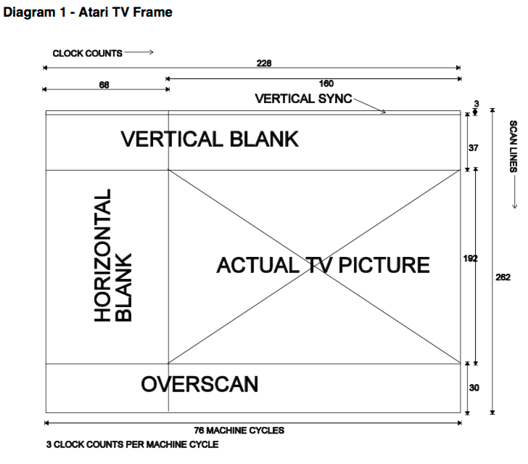
Notes:
We take for granted everything related to space on a screen having a definitive xy coordinate system. This didn’t exist in the past. We have to write it, make it happen, and then go.
And it varies wildly.

Slide 16
legendary games
Notes:
We also found innumerable games that formed the basis of a TON of genre and types.

Slide 17
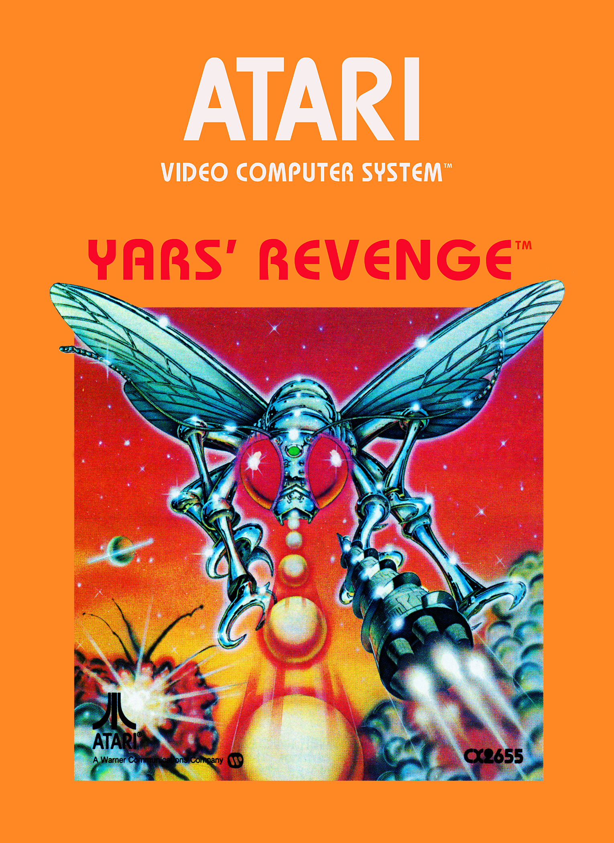
Howard Scott Warshaw still considered a top 100 game

Slide 18
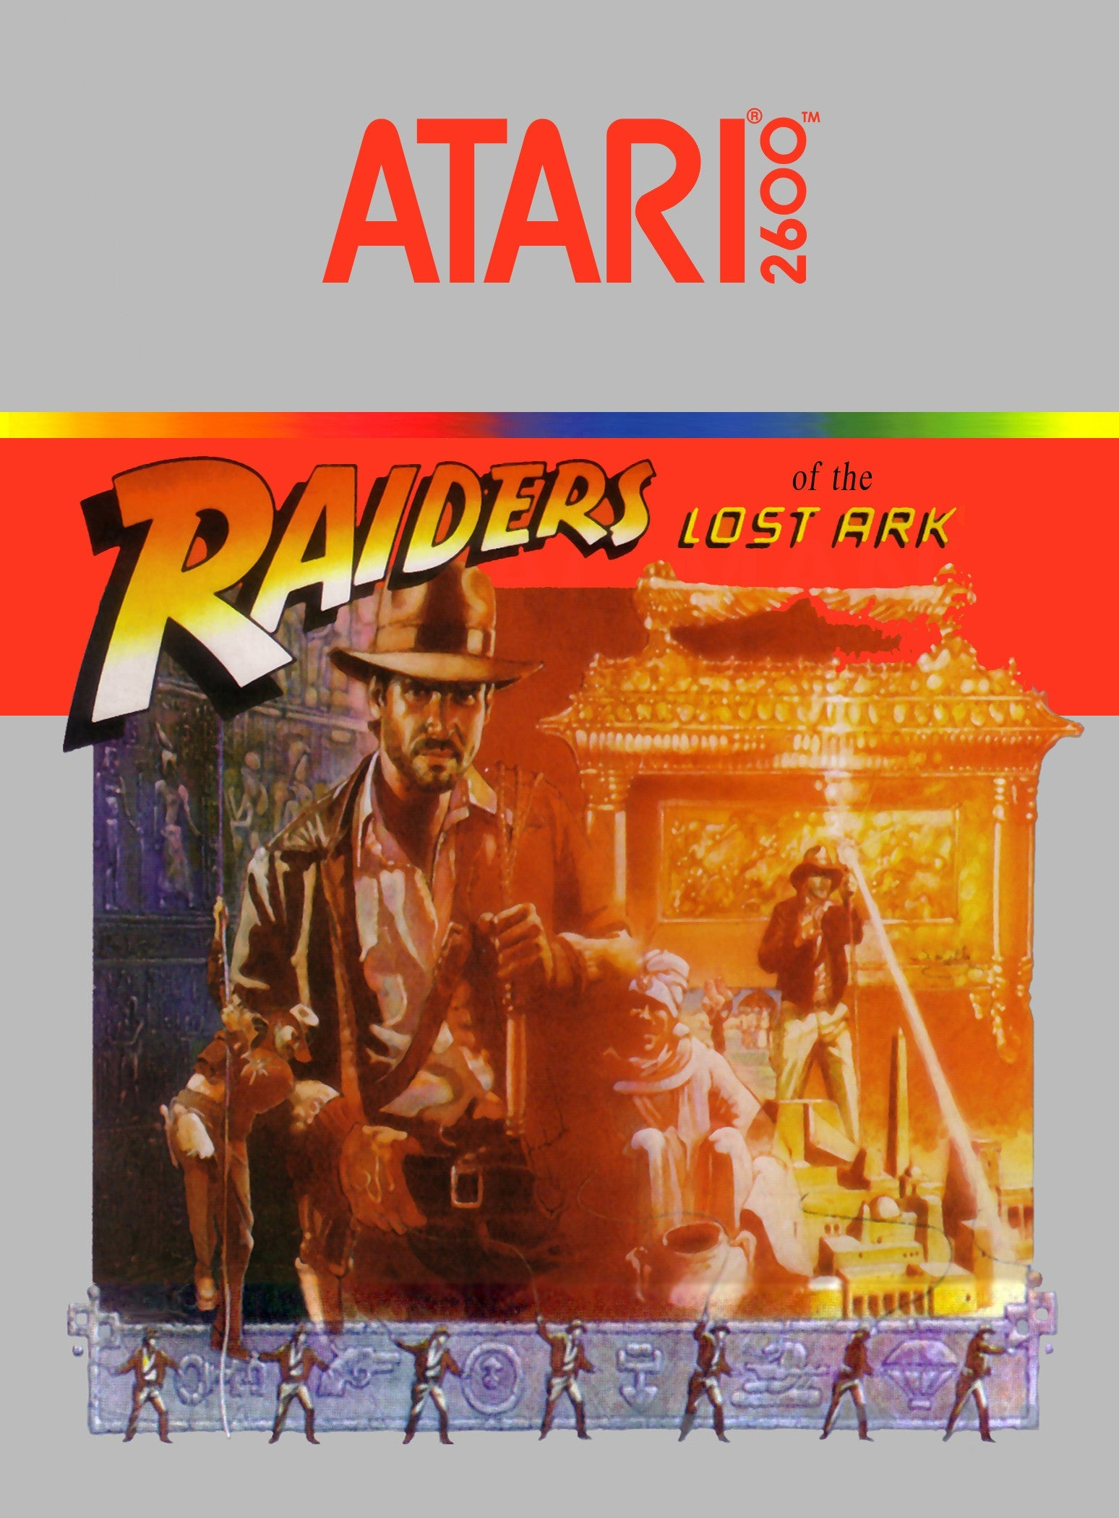
Howard Scott Warshaw surprisingly complex

Slide 19
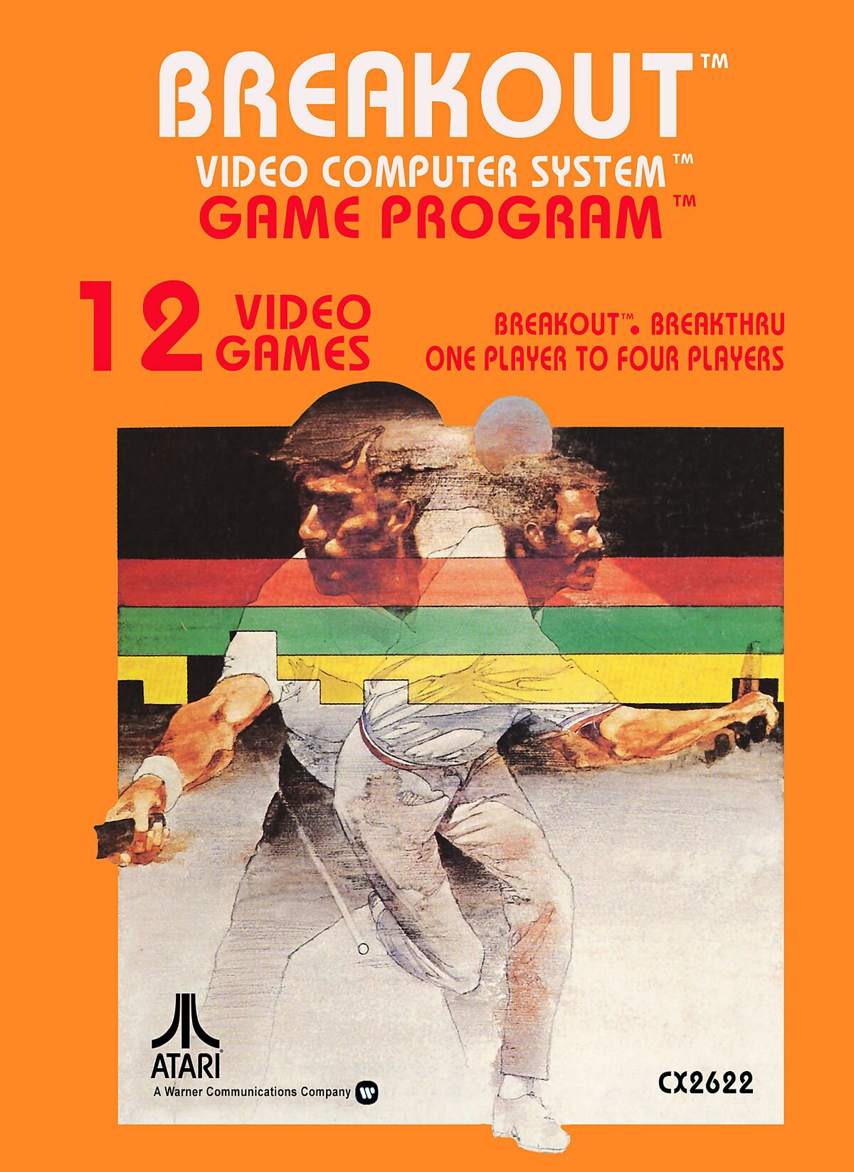
why is this here?
Notes:
Woz wrote original port, Brad Stewart wrote 2600 version. I wanted to note it here.

Slide 20
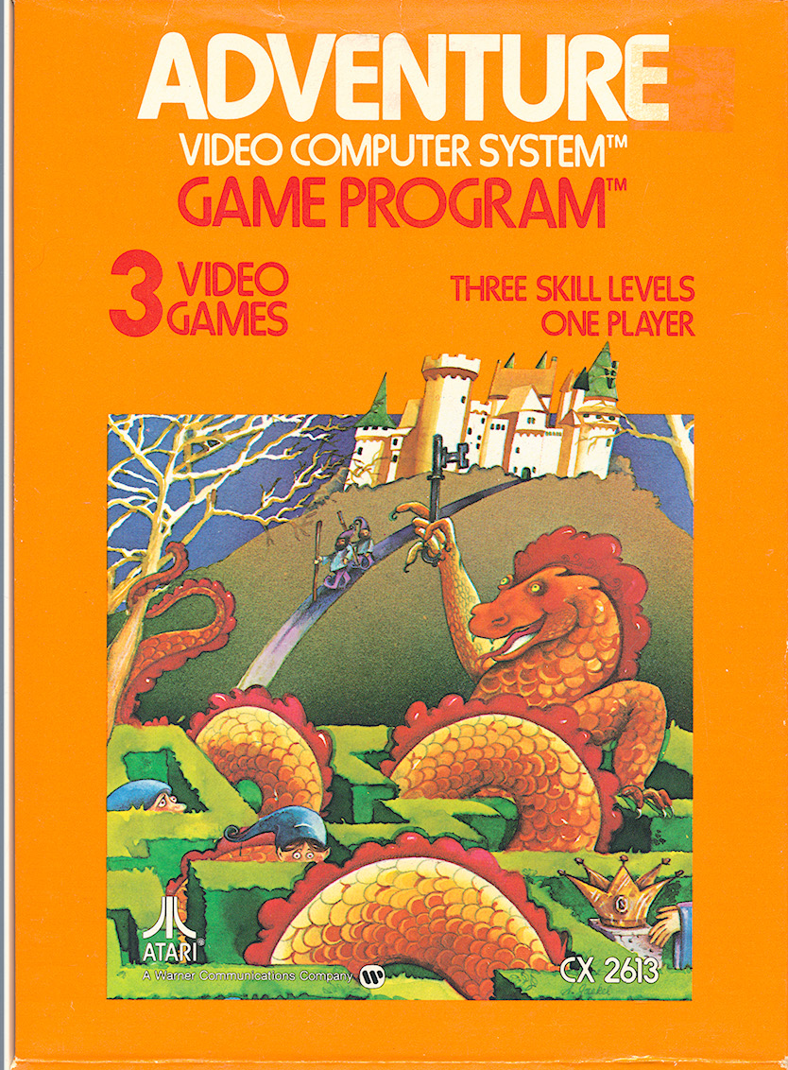
You guys are no more important to Atari than the guy on the assembly line who assembles the cartridges.
Notes:
Warren Robinett

Slide 21
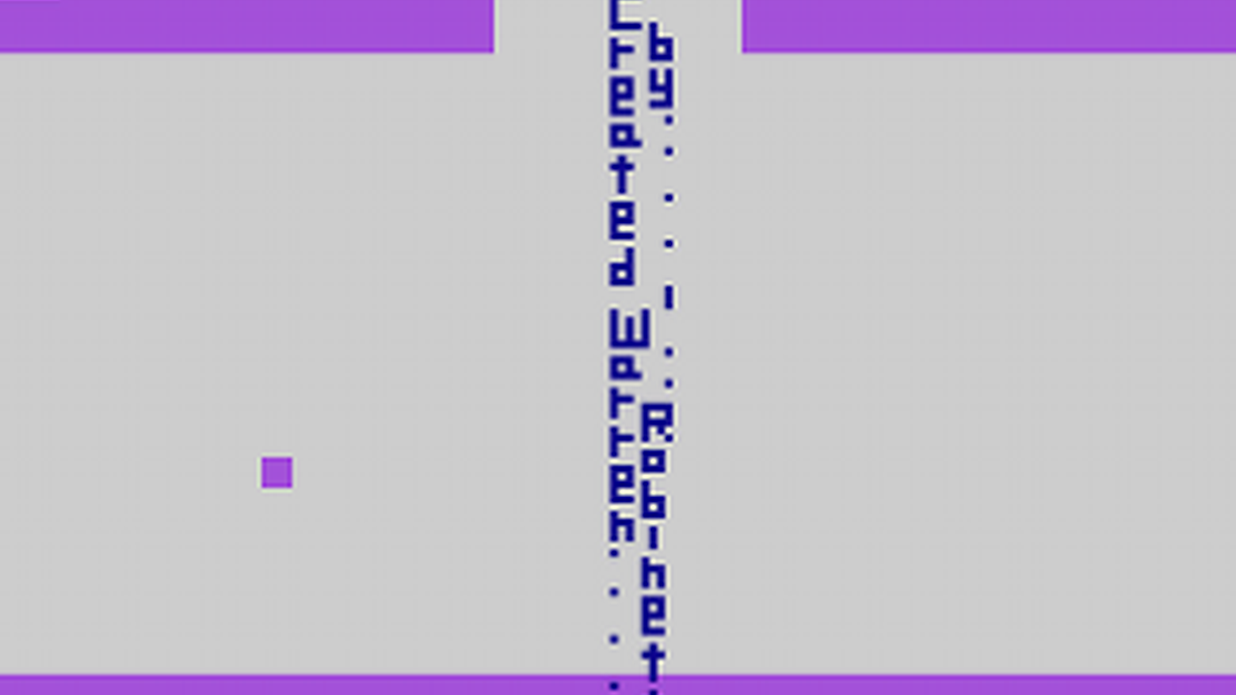

Slide 22
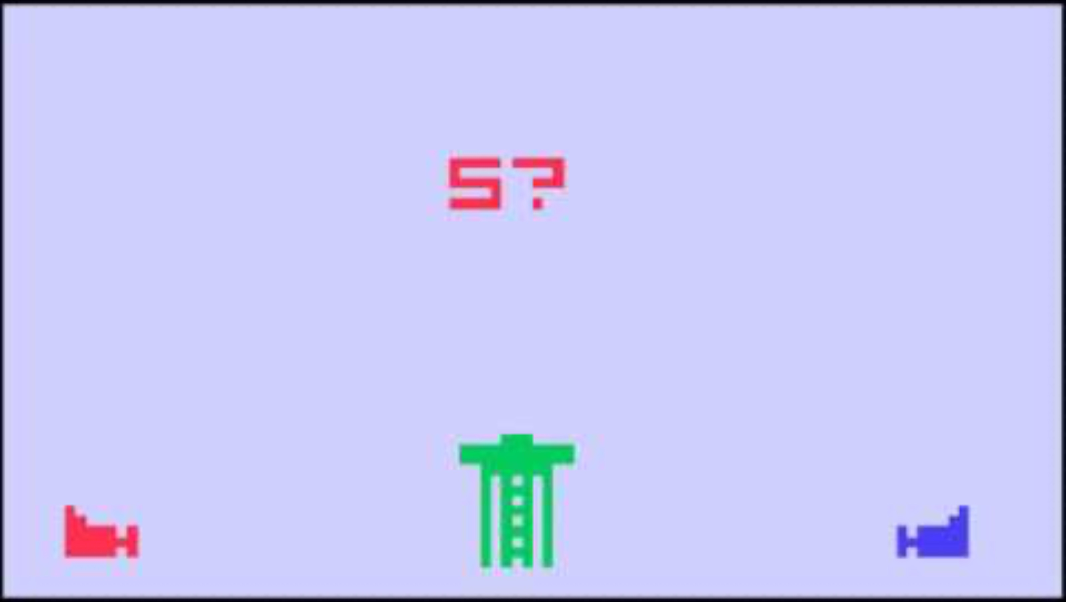

Slide 23

Carol Shaw best Selling scrolling still important
Notes:
River Raid: https://www.inverse.com/gaming/river-raid-40th-anniversary-carol-shaw
One of the best selling games for the 2600, ported everywhere. One of the first games designed by a woman. The source code for this game is at the Strong. She hand wrote it.

Slide 24
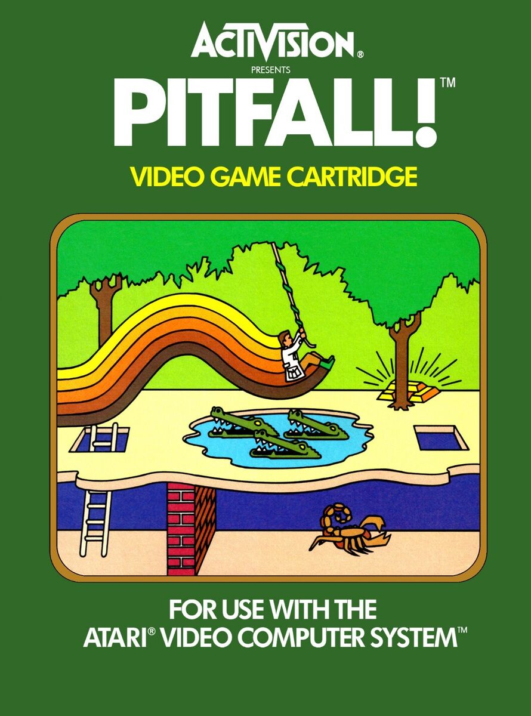
David Crane 255 Screens platformer procgen
Notes:
Crane commented that "The entire [game design] process took about 10 minutes. About 1000 hours of programming later the game was complete."^{[11]} Much of Crane's time was spent optimizing and compressing the code so that it would fit into a four-kilobyte ROM cartridge.^{[16]} Unlike Haunted House (1982) or Raiders of the Lost Ark (1982), where the environments were hard-coded into the game, Pitfall! was generated constantly by code.^{[13]} The game generates each screen based on a counter that could run either backwards or forwards depending which direction the player moved from screen to screen.^{[17]} The 8 bits in the counter were used to determine certain details such as the background, trees, ground and object patterns, allowing 255 screens to occupy fewer than 50 bytes of ROM.^{[18]} Activision had created design centers for their games, which were small, close-knit teams of four to five people.^{[19]} These teams encouraged peer reviews and shared prototypes of games. In Pitfall!, Crane's team changed the initial number of lives in the game from one to three during the final week of development.^{[20]} Crane said that "my buddies practically tied me to my chair until I put in extra lives and I'm glad they did".^{[20]}

Slide 25
how class work?

Slide 26
assembly 6502

Slide 27
a caveat

Slide 28

a caveat

Slide 29
3 tasks

Slide 30
read and write

Slide 31

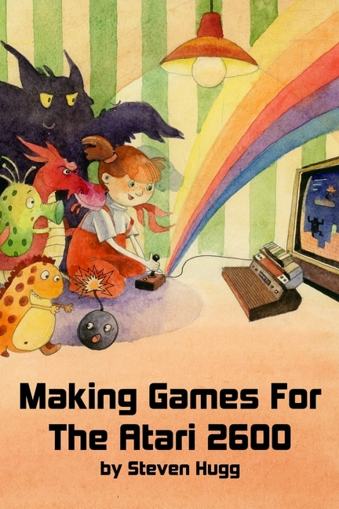

Slide 32
source code problems

Slide 33
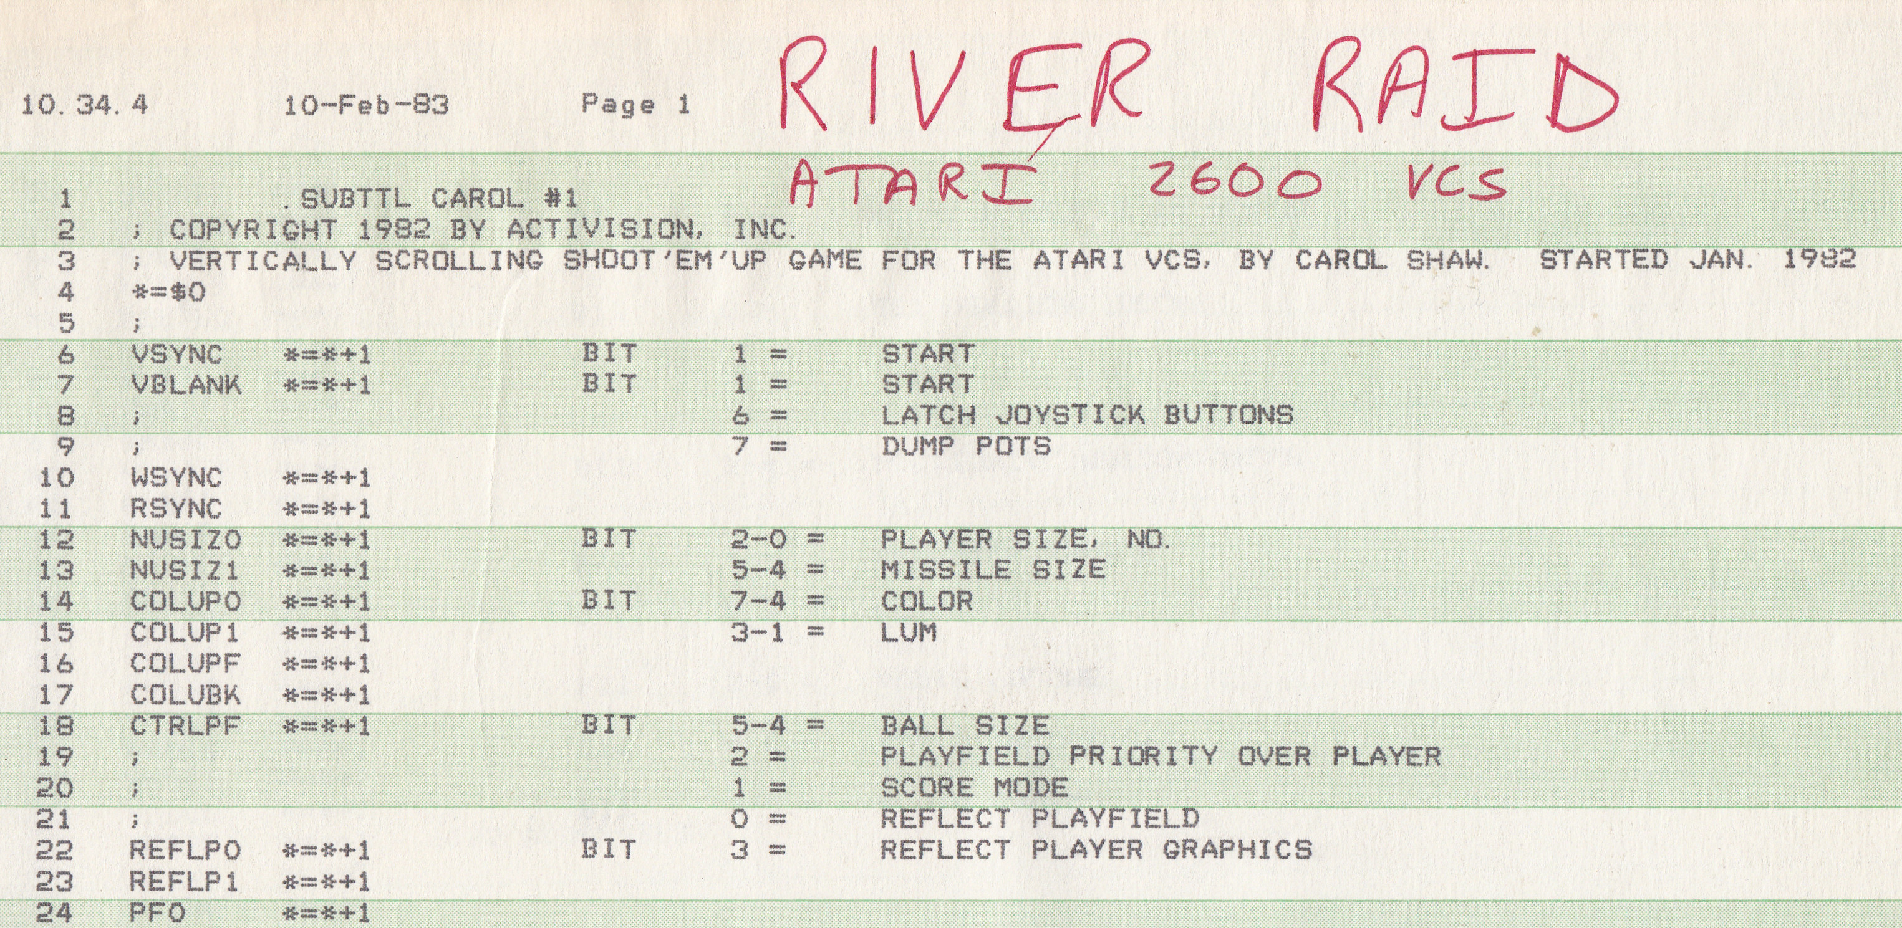

Slide 34
ET Challenge

Slide 35

5 weeks alone? team? full game
Notes:
Activision had created design centers for their games, which were small, close-knit teams of four to five people.^{[19]} These teams encouraged peer reviews and shared prototypes of games. In Pitfall!, Crane's team changed the initial number of lives in the game from one to three during the final week of development.^{[20]} Crane said that "my buddies practically tied me to my chair until I put in extra lives and I'm glad they did".^{[20]}

Slide 36
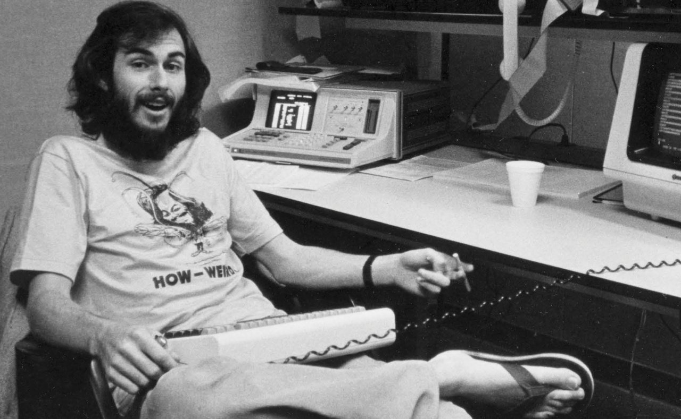

Slide 37
the 2600 was a real mess.

Slide 38
it's a good thing that we don't try to program machines like that anymore because it was just absurd.

Slide 39
but it was kind of fun in a sick way if you like that kind of challenge.

Slide 40
dark souls of designing games

Slide 41


Slide 42
qcc?

